Slide 1

Bright Motors car sales
Tinyiko Novela

Slide 2

Agenda
Introduction
Key metrics
Insights
Recommendations
Q&A

Slide 3

Introduction
Bright Motors is a major automotive retailer in the United states.
It operates over 14000 dealerships continent-wide.
Recently, a new sales director has been appointed to drive further growth.

Slide 4

Goals for Bright motors
Business priorities
Expand the dealership network
Improve sales performance
Optimize inventory
Draw insights from historical data to guide sales and marketing campaigns

Slide 5
Key metrics
REVENUE
$7 606 175 619
SALES
558 811
Profit
$-88 303 984
DEALERSHIPS
14261

Slide 6
Consumer trends
INSIGHT
The highest number of purchases is in the winter months
Generally, high number of sales equals to a higher revenue, however, that is not always the case(May, Mar and Dec)
Takeaway
This is due to a significant difference in the price of the units

Slide 7
Consumer trends
INSIGHT
Wednesday is the busiest day of the week and people prefer to but cars between 00:00 and 06:00

Slide 8
Profit margins
Revenue | Expenses | Profit
$7 606 175 619 | $7 694 479 603 | -$88 303 984
INSIGHT
The total wholesale value of the cars is higher than the total selling price
76% of the profit margins are low
Takeaway
Even though revenue is in the billions, net profit is on the negative, company is losing money

Slide 9
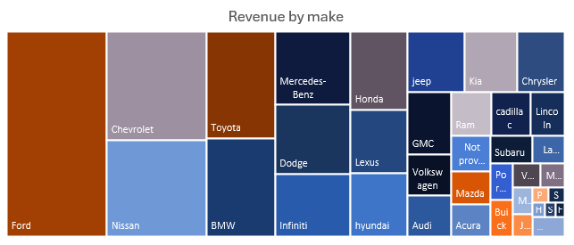
Revenue by make and model
INSIGHT
Ford makes the highest revenue
5 out of the 10 model bestsellers is from Ford
Make | Model | Revenue
Ford | F-150 | $272 669 759
Nissan | Altima | $220 986 008
Ford | Escape | $165 966 502
Ford | Fusion | $159 926 131
Infiniti | G Sedan | $147 918 806
Ford | Explorer | $140 504 869
Toyota | Camry | $140 259 583
BMW | 3 Series | $137 906 230
Ford | Edge | $110 867 719
Chevrolet | Silverado 1500 | $107 318 746
Takeaway
Affordable brands are leading in terms of revenue
High end luxurious cars make lower sales

Slide 10
Price, mileage and year of manufacture
INSIGHT
Customers prefer new/low mileage cars to older ones
70% of customers are buying cars that cost less than $10000
Very old models(21-44 years) cost less and have low sales
Takeaway
Management of inventory levels: Low inventory levels for very old, high mileage and expensive cars

Slide 11
Regions with high sales volumes
INSIGHT
Florida has the highest revenue
10 states account for 75% of the revenue
Takeaway
Key business improvements should focus on these 10 sates

Slide 12
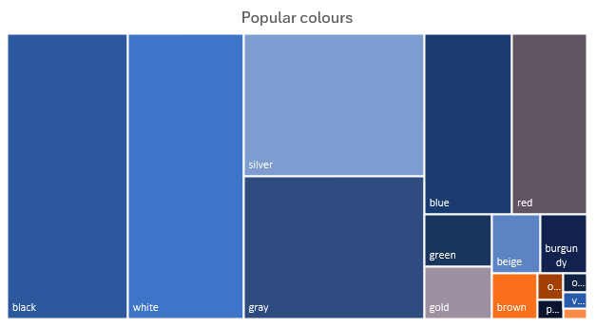
Consumer trends
INSIGHT
Customers prefer the convenience of automatic transmission over a manual one
Black and white cars are the most popular
Takeaway
Management of inventory levels: order popular colors and automatic transmissions

Slide 13
Recommendations
Reduce the number of dealerships in low performing states and expand on the best performing ones
Increase selling price to increase profit margins
Manage inventory levels and order based on need
Pay sales people by commission to encourage hard work
Ensure expenses stay under budget so that it doesn’t eat into profit
Launch sales and marketing campaigns for budget friendly cars
Consider reducing the work week from 7 days to three days to cut operational costs

Slide 14

Thank you
Q& A

